Slide 1

Twitter Tweets – COVID Vaccine
Business Problem:
Many people are still seeing the affects of COVID-19 after over a year of the virus
Many ways to find information about COVID-19 such as websites, social media, and news
At times, it is hard to differentiate between misinformation and correct information
Finding the best way to communicate information about COVID is tough
Social media websites such as Twitter is one way to get COVID information out to a lot of people

Slide 2
Twitter Tweets – COVID Vaccine
Hypothesis:
A lot of COVID vaccine information people and companies will tweet and retweet about on Twitter
Common words that should appear in tweets such as COVID, vaccines, and COVID-19
A lot of positive and negative connotations for words associated with COVID-19
More positive words in tweets than there will be negative words
A lot of screen names that tweet about COVID-19 such as companies that want to get vaccine and testing information out to consumers, bots, and individuals

Slide 3
Twitter Tweets – COVID Vaccine
Dataset Information:
Dataset used is from Twitter
Keywords searched include “COVID Vaccine”
Does not include retweets
Allows a person to download up to 18,000 records at a time every 15 minutes
Without a Twitter subscription, the data only goes back 8 days
There are a lot of fields that Twitter stores information for
Fields that were mainly used to review the tweets are screen_name, text (tweet), source (what device was used to tweet), location, followers_count, friends_count, and account_created_at

Slide 4
Twitter Tweets – COVID Vaccine
Methods:
Text mining from Twitter using an API
Word Networks
Sentiment Analysis

Slide 5
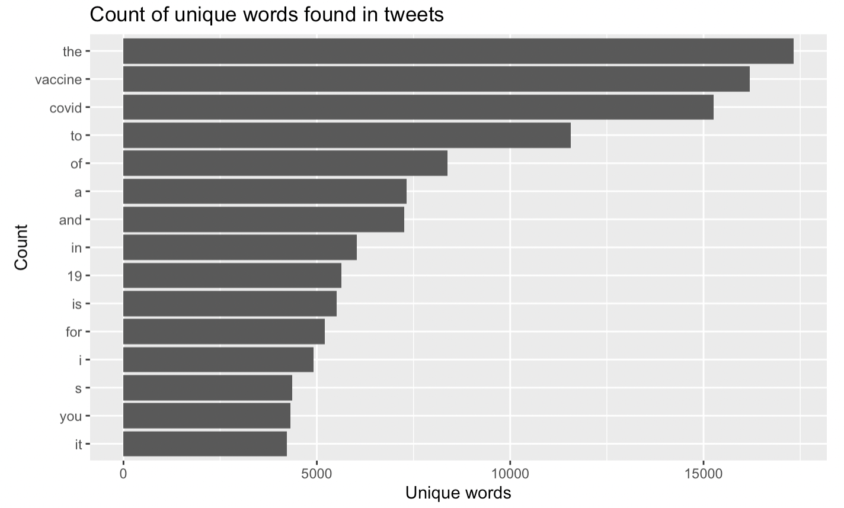
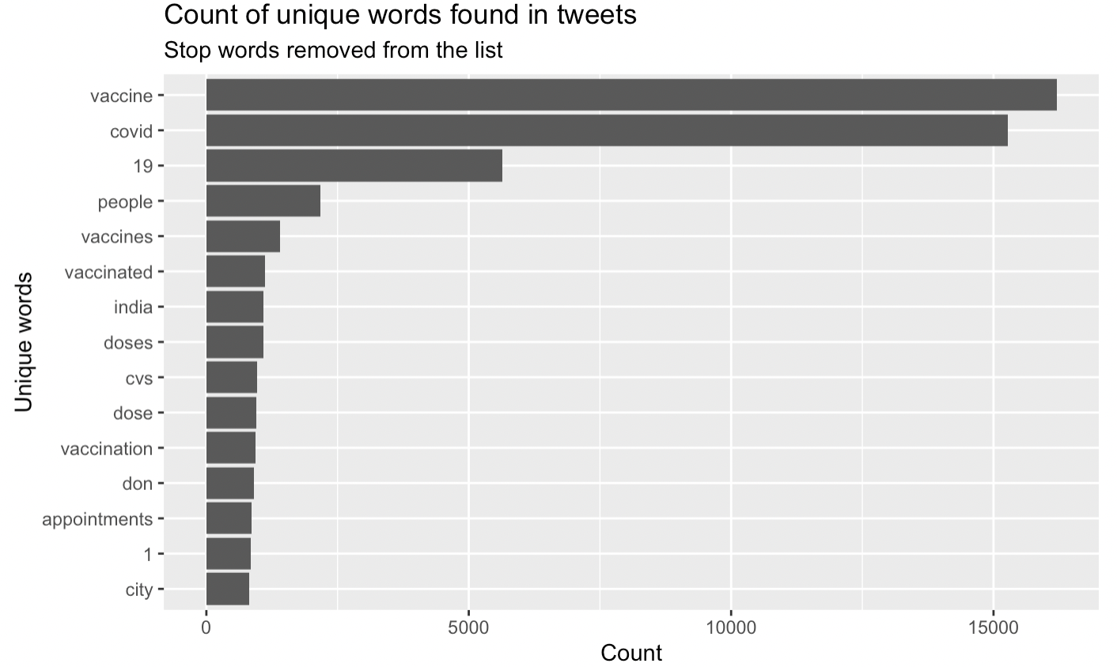
Twitter Tweets – COVID Vaccine

Slide 6
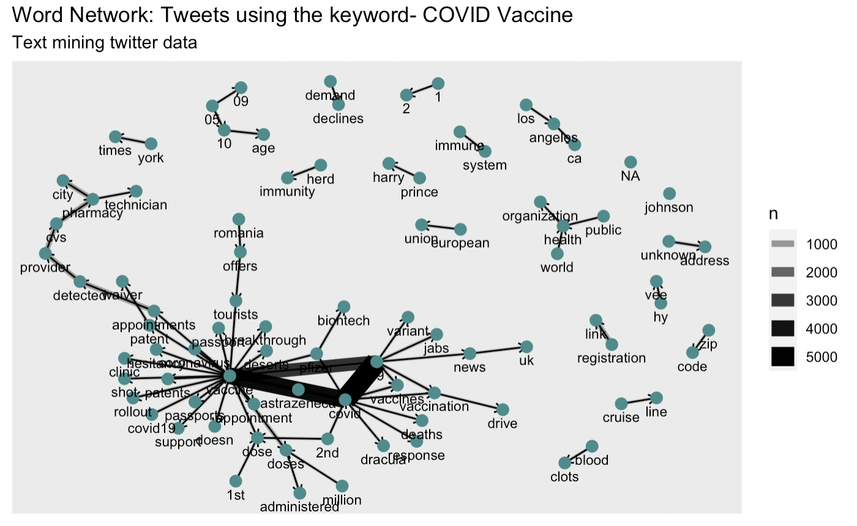
Twitter Tweets – COVID Vaccine

Slide 7
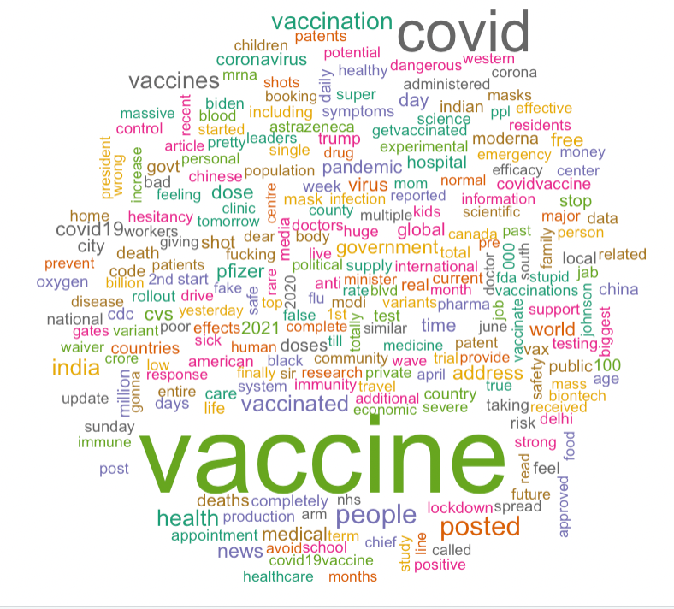
Twitter Tweets – COVID Vaccine

Slide 8
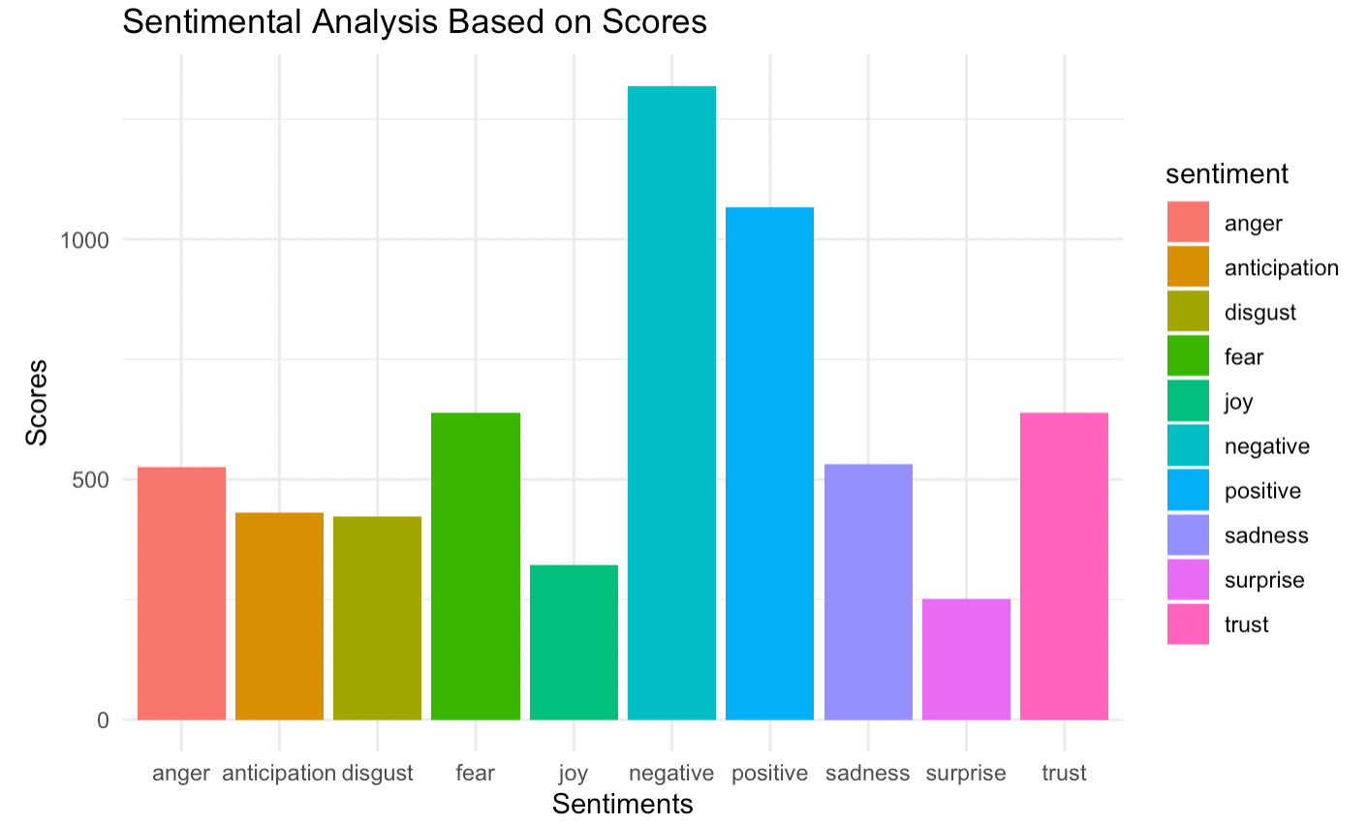
Twitter Tweets – COVID Vaccine

Slide 9
Twitter Tweets – COVID Vaccine
Conclusion:
There are many ways to analyze Twitter tweets
Cleaning the data in Twitter tweets can take time as there can be so many different variations of words
Throughout the last four weeks, various tweet word utilizations have changed when analyzing the keywords “COVID Vaccine”
After reviewing the sentimental analysis, I found that there were more negative words than positive words
There were various screen names that tweeted about COVID within the last 8 days which included consumers, bots, and individuals

